Slide 1
Cultured Podcast
By the Lads and the Gang
Also by cultured gentlemen

Slide 2
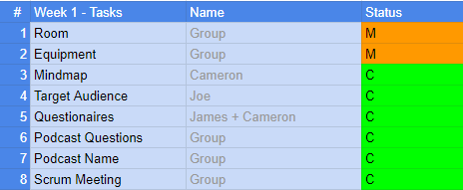
Last weeks Kanban

Slide 3

What we have done?
Thought up of a name, logo and mascot for the podcast. We have also thought up of questions to ask each other in the podcast.
This is Baiyo!

Slide 4
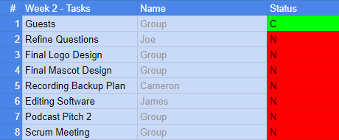
This weeks Kanban

